Slide 1
The Data Warehouse Toolkit
By Ralph Kimball
Chapter 1: Dimensional Modeling Primer
Prepared by: Song Nguyen
Date: Feb/18/2019

Slide 2
1.0 Introduction
Discuss the following concepts:
Business-driven goals of a data warehouse.
Data warehouse publishing.
Major components of the overall data warehouse.
Importance of dimensional modeling for the data warehouse presentation area.
Fact and dimension table terminology.
Myths surrounding dimensional modeling.
Common data warehousing pitfalls to avoid.

Slide 3
1.1 Different Information Worlds
One of the most important assets of any organization is its information.
The users of an operational system turn the wheels of the organization.
The users of a data warehouse, on the other hand, watch the wheels of the organization turn

Slide 4
1.2 Goals of a Data Warehouse
“We have mountains of data in this company, but we can’t access it.”
“We need to slice and dice the data every which way.”
“You’ve got to make it easy for business people to get at the data directly.”
“Just show me what is important.”
“It drives me crazy to have two people present the same business metrics at a meeting, but with different numbers.”
“We want people to use information to support more fact-based decision making.”

Slide 5
1.2 Goals of a Data Warehouse (ct)
The data warehouse must make an organization’s information easily accessible.
The data warehouse must present the organization’s information consistently.
The data warehouse must be adaptive and resilient to change.
The data warehouse must be a secure bastion that protects our information assets.
The data warehouse must serve as the foundation for improved decision making.
The business community must accept the data warehouse if it is to be deemed successful.

Slide 6
1.2.1 The Publishing Metaphor Activities
Identify your readers demographically.
Find out what the readers want in this kind of magazine.
Identify the “best” readers who will renew their subscriptions and buy products from the magazine’s advertisers.
Find potential new readers and make them aware of the magazine.
Choose the magazine content most appealing to the target readers.
Make layout and rendering decisions that maximize the readers’ pleasure.
Uphold high quality writing and editing standards, while adopting a consistent presentation style.
Continuously monitor the accuracy of the articles and advertiser’s claims.
Develop a good network of writers and contributors as you gather new input to the magazine’s content from a variety of sources.
Attract advertising and run the magazine profitably.
Publish the magazine on a regular basis.
Maintain the readers’ trust.
Keep the business owners happy.

Slide 7
1.2.1 The Publishing Metaphor (1)
Make sure the data is accurate and can be trusted, labeling it consistently across the enterprise.
Continuously monitor the accuracy of the data and the content of the delivered reports.
Search for new data sources, and continuously adapt the data warehouse to changing data profiles, reporting requirements, and business priorities.
Take a portion of the credit for the business decisions made using the data warehouse, and use these successes to justify your staffing, software, and hardware expenditures.
Publish the data on a regular basis.
Maintain the trust of business users.
Keep your business users, executive sponsors, and boss happy.

Slide 8
1.2.1 The Publishing Metaphor (2)
Understand your users by business area, job responsibilities, and computer tolerance.
Determine the decisions the business users want to make with the help of the data warehouse.
Identify the “best” users who make effective, high-impact decisions using the data warehouse.
Find potential new users and make them aware of the data warehouse.
Choose the most effective, actionable subset of the data to present in the data warehouse, drawn from the vast universe of possible data in your organization.
Make the user interfaces and applications simple and template-driven, explicitly matching to the users’ cognitive processing profiles.

Slide 9
1.3 Components of a Data Warehouse
Each warehouse component serves a specific function.
There are four separate and distinct components to be considered as we explore the data warehouse environment:
  Operational source systems.
  Data staging area.
  Data presentation area.
  Data access tools.

Slide 10
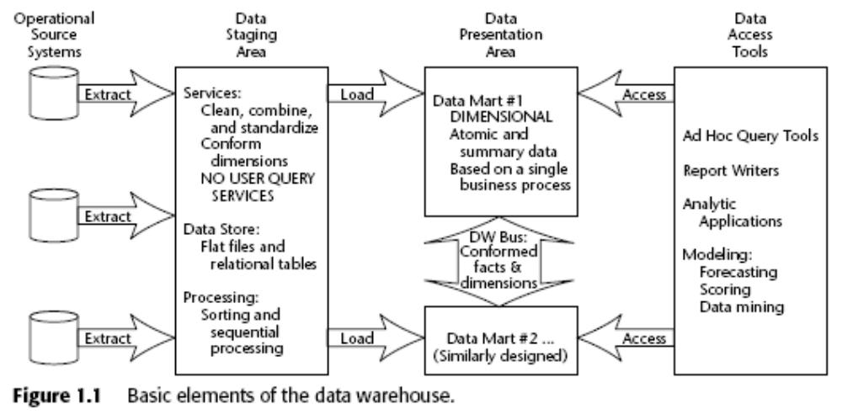
1.3.1 Operational Source Systems

Slide 11
1.3.2 Data Staging Area
The data staging area of the data warehouse is both a storage area and a set of processes commonly referred to as extract-transformation-load (ETL).
The data staging area is everything between the operational source systems and the data presentation area.
The key architectural requirement for the data staging area is that it is off-limits to business users and does not provide query and presentation services.

Slide 12
1.3.3 Data Presentation
The data presentation area is where data is organized, stored, and made available for direct querying by users, report writers, and other analytical applications.
We typically refer to the presentation area as a series of integrated data marts.
Dimensional modeling is a new name for an old technique for making databases simple and understandable.
Notes: It is acceptable to create a normalized database to support the staging processes; however, this is not the end goal. The normalized structures must be off-limits to user
By default, normalized databases are excluded from the presentation area, which should be strictly dimensionally structured.
Data in the queryable presentation area of the data warehouse must be dimensional, must be atomic, and must adhere to the data warehouse bus architecture.

Slide 13
1.3.4 Data Access Tools
The final major component of the data warehouse environment is the data access tool.
A data access tool can be as simple as an ad hoc query tool or as complex as a sophisticated data mining or modeling application.

Slide 14
1.3.5 Additional Considerations
Metadata: Metadata is all the information in the data warehouse environment that is not the actual data itself.
Operational Data Store: The place in the data warehouse where we store granular atomic data. ODS is implemented to deliver operational reporting.
The ODS as a reporting instance may be a steppingstone to feed operational data into the warehouse

Slide 15
1.4 Dimensional Modeling Vocabulary
Throughout this book we will refer repeatedly to fact and dimension tables.

Slide 16
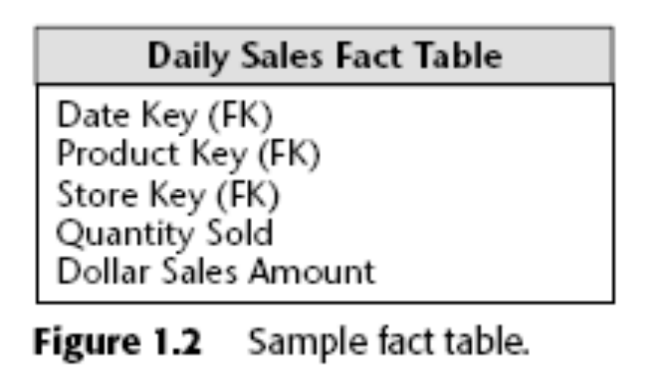
1.4.1 Fact Table
A fact table is the primary table in a dimensional model. Fact table grains fall into one of three categories: transaction, periodic snapshot, and accumulating snapshot.
The most useful facts are numeric and additive. A measurement is a row in a fact table. All the measurements in a fact table must be at the same grain. (Note: Semi-additive, non-additive facts)

Slide 17
1.4.2 Dimension Tables
Dimension tables are integral companions to a fact table, contain the textual descriptors of the business, have many columns or attributes.
Dimension attributes serve as the primary source of query constraints, groupings, and report labels.
Dimension table attributes play a vital role in the data warehouse.
Robust dimension attributes deliver robust analytic slicing and dicing capabilities. The dimensions implement the user interface to the data warehouse.
Fact tables express the many-to-many relationships between dimensions in dimensional models.
The fact table has its own primary key made up of a subset of dimensions’ foreign keys or a composite key.

Slide 18
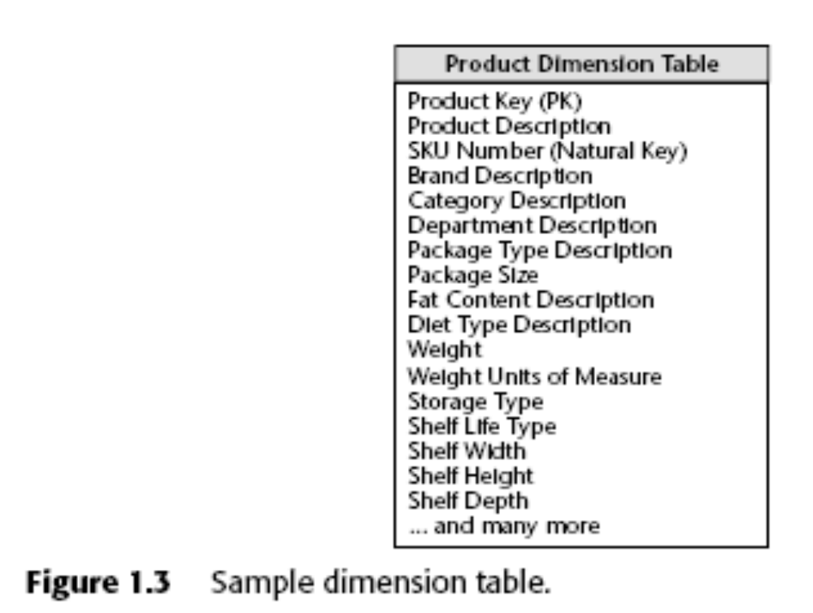
1.4.2 Dimension Tables (ct)

Slide 19
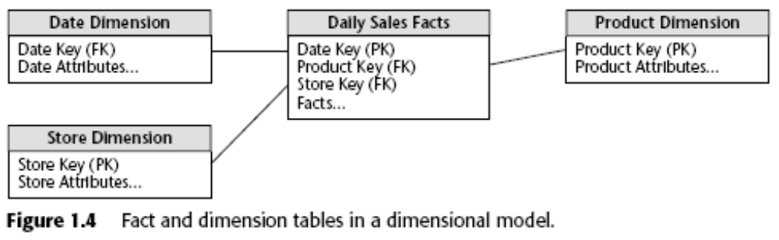
1.4.3 Bringing Together Facts and Dimensions
This characteristic starlike structure is often called a star join schema. This term dates back to the earliest days of relational databases.

Slide 20
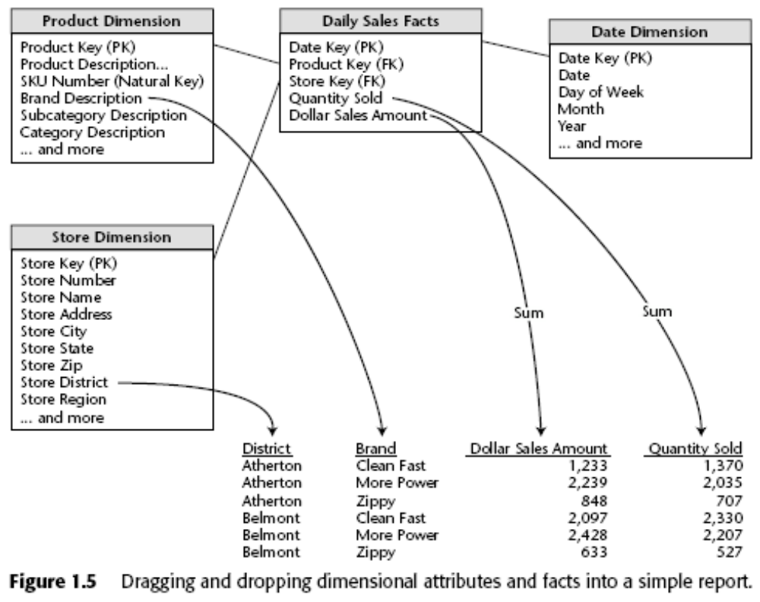
1.4.3 Bringing Together Facts and Dimensions

Slide 21
1.5 Dimensional Modeling Myths
Myth 1. Dimensional models and data marts are for summary data only.
Myth 2. Dimensional models and data marts are departmental, not enterprise, solutions.
Myth 3. Dimensional models and data marts are not scalable.
Myth 4. Dimensional models and data marts are only appropriate when there is a predictable usage pattern.
Myth 5. Dimensional models and data marts can’t be integrated and therefore lead to stovepipe solutions.

Slide 22
1.5.1 Common Pitfalls to Avoid
Pitfall 10. Become overly enamored with technology and data rather than focusing on the business’s requirements and goals.
Pitfall 9. Fail to embrace or recruit an influential, accessible, and reasonable management visionary as the business sponsor of the data warehouse.
Pitfall 8. Tackle a galactic multiyear project rather than pursuing more manageable,
while still compelling, iterative development efforts.
Pitfall 7. Allocate energy to construct a normalized data structure, yet run out of budget before building a viable presentation area based on dimensional models.
Pitfall 6. Pay more attention to backroom operational performance and ease of development than to front-room query performance and ease of use.

Slide 23
1.5.1 Common Pitfalls to Avoid (ct)
Pitfall 5. Make the supposedly queryable data in the presentation area overly complex. Database designers who prefer a more complex presentation should spend a year supporting business users; they’d develop a much better appreciation for the need to seek simpler solutions.
Pitfall 4. Populate dimensional models on a standalone basis without regard to a data architecture that ties them together using shared, conformed dimensions.
Pitfall 3. Load only summarized data into the presentation area’s dimensional structures.
Pitfall 2. Presume that the business, its requirements and analytics, and the underlying data and the supporting technology are static.
Pitfall 1. Neglect to acknowledge that data warehouse success is tied directly to user acceptance. If the users haven’t accepted the data warehouse as a foundation for improved decision making, then your efforts have been exercises in futility.

Slide 24
Summary
The differences between data warehouses and operational source systems.
Dimensional modeling for the presentation area.
Established preliminary vocabulary regarding facts and dimensions.

